Slide 1
Introduction to Software Testing
Session 16

Slide 2
Feedback on HW5
Not all “requirements” are created equal!

Slide 3
Proj2 Hints

Slide 4
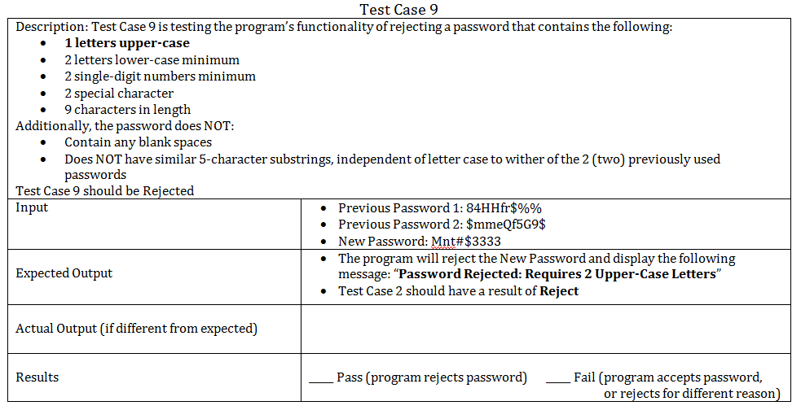
This is not a test case!
Mnt#$3333
84HHfr$%%
$mmeQfG9$
R (not enough upper-case characters)
This IS a test case, however…

Slide 5
For Project 2, you will need both of these…
Mnt#$3333
84HHfr$%%
$mmeQfG9$
R (not enough upper-case characters)
a test file to run an automated test
and a test plan for review (could be used for manual testing, too)

Slide 6
Which cases?
Let A = set of test cases derived in HW3
Let B = set of test cases derived in HW4
Let C = set of test cases derived in HW5
Let P = set of test cases submitted in Proj2
P ≠ A ∪ B ∪ C
P ⊄ A ∪ B ∪ C
THINK:
Every submission will have 30 test cases, but NOT every submission will describe and justify them to the same degree
This is your chance to shine…
Don’t make it hard for me to figure out what each case is testing
Don’t assume I’ll be able to figure out why you chose each test case

Slide 7
Your write-up…
Should clearly explain how you synthesized the results of the three associated HW assignments
Should list these in a comprehensive test plan, ready for Alice
Should have extra documentation for the instructor

Slide 8
Your .txt file
Used for automated testing; have it posted on Pilot on (but not before) Monday.
Come to class Monday ready to run files.

Slide 9
TDD (wait for my signal )
If you have not used TDD in your coding so far
If you have used TDD, and have noticed a difference
If you have used TDD, but have not noticed a difference

Slide 10
Timing of this assignment
Who is almost ready now?
Who could use more time?
Who is almost ready now?
Who could use more time?

